Slide 1

Crypto Beacon: Android Crypto Guide - Illuminating Crypto Frontiers
DONE BY:
SRI RAGHAVARDHINI.M (21BIT101)
GUIDED BY:
DR. S. BEULA PRINCY., M.Sc., Ph.D.,
Assistant Professor, Department of Information Technology,
PSGR Krishnammal College for Women,
Coimbatore-641004

Slide 2
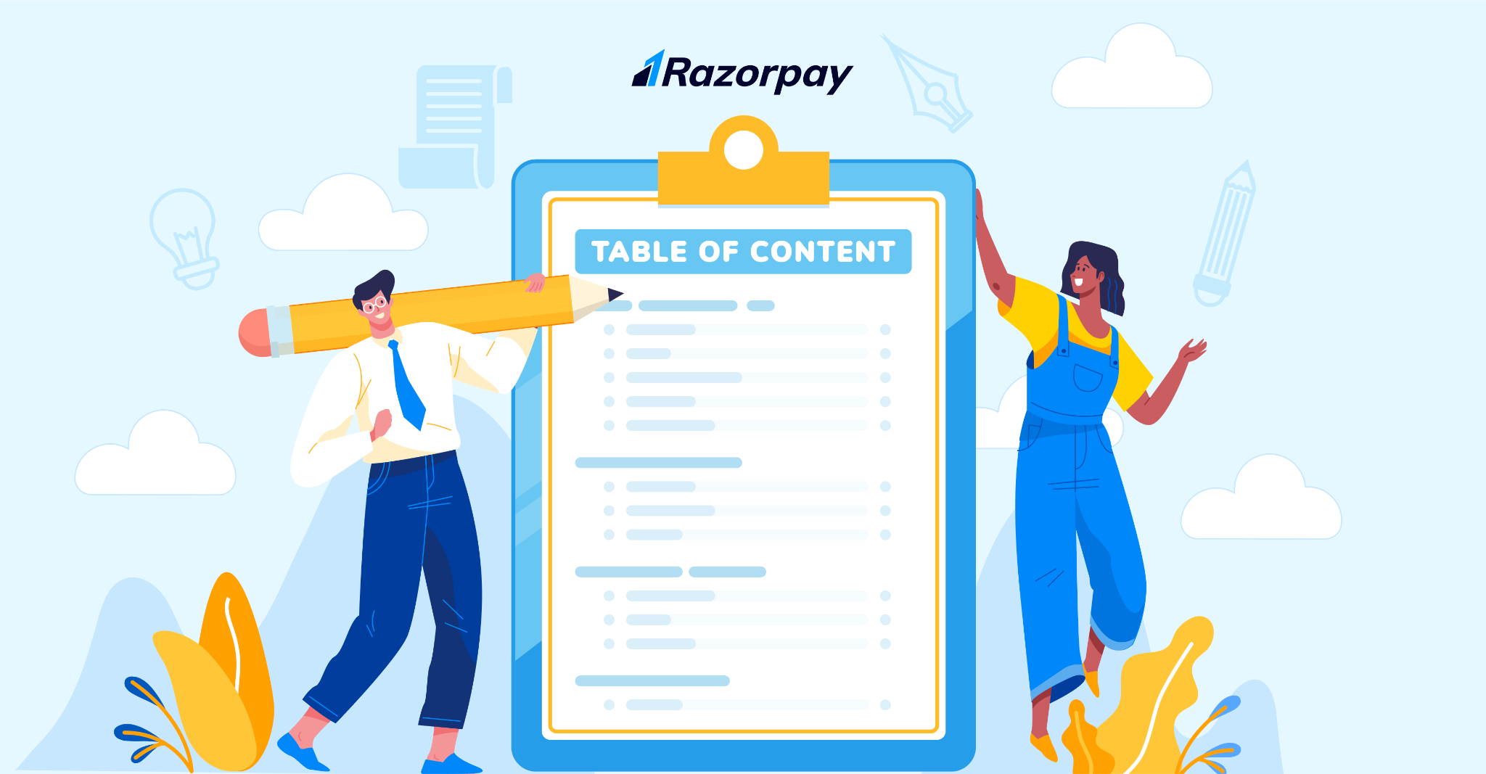
Contents
1. Introduction
2. System Requirement Specification
2.1.Hardware Requirement
2.2.Software Requirement
3. System analysis
3.1.Existing System
3.2.Proposed System
4. System Design
4.1.DFD diagrams
4.2.output designs
5.Conclution
5.1.Future enhancement

Slide 3
INTRODUCTION
By seamlessly integrating the CryptoCompare API, the application harnesses a wealth of information, providing users with live updates on currency rates, market trends, and mining statistics.
An integral facet of this project lies in its use of SQLite as a local database,ensuring the secure and personalized storage of user data.
This process of real-time data retrieval, secure local data storage.

Slide 4
2. System Requirement Specification
2.1.Hardware Requirements:
Processor : Intel(R) Core(TM) i5-6500T CPU @ 2.50GH
Installed memory (RAM) : 8 GB
Hard Disk : 160 GB
Operating System : Windows 10
2.2.Software Requirements:
Front-End : Flutter
Back-End : Crypto Compare API, Coin Market Cap API
Tool : Android Studio, Visual Studio Code
Database : SQLite

Slide 5
3. System analysis
3.1.Existing System:
The existing system in the cryptocurrency domain often lacks a unified and user-friendly platform for accessing real-time data, especially when catering to users in specific regions such as India. Currently, users face challenges in obtaining accurate and timely information on cryptocurrency prices, mining statistics, and related news, with limited options for personalizing their experience. Existing applications may lack a seamless integration of diverse functionalities and may not offer a secure and convenient means for users to store their preferences and historical data.

Slide 6
3.2.Proposed System:
Unified Data Integration : Implement a robust data integration strategy that consolidates information from various sources, ensuring real-time and accurate data on cryptocurrency prices, mining statistics, and news within a single platform.
Focused Mining Statistics : Incorporate comprehensive mining statistics, including hash rates, block rewards, and mining difficulty, offering enthusiasts valuable insights into the mining aspect of the cryptocurrency ecosystem.
Prominent News Integration : Strengthen news integration by prominently featuring cryptocurrency-related news within the application, ensuring users stay informed about market trends, regulatory changes, and technological advancements.

Slide 7
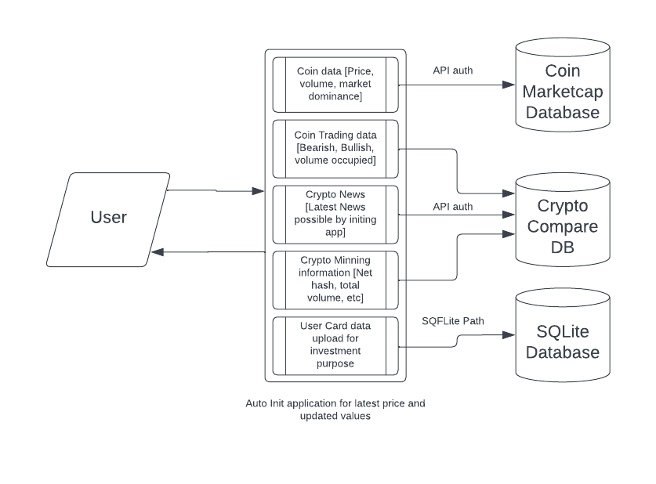
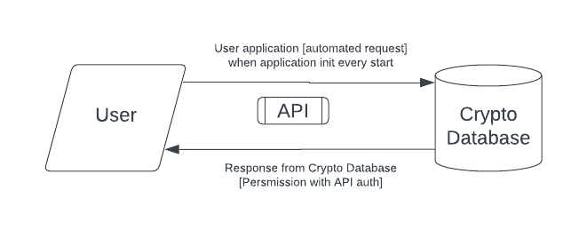
4. System Design
4.1.DFD diagrams:
Level 0:
Level 1:

Slide 8
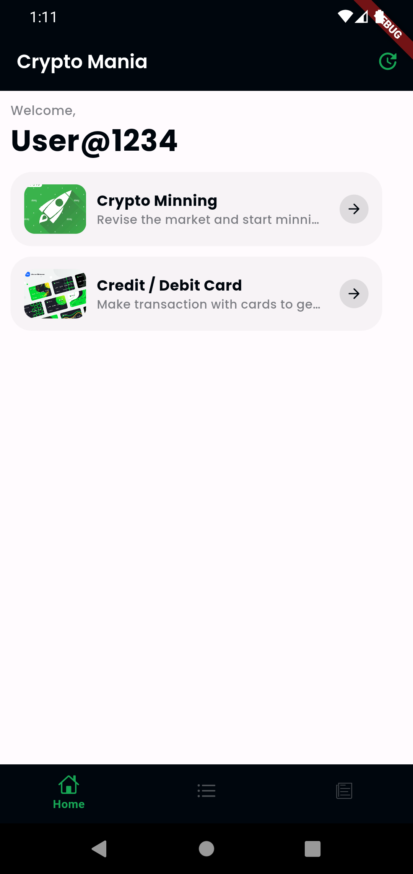
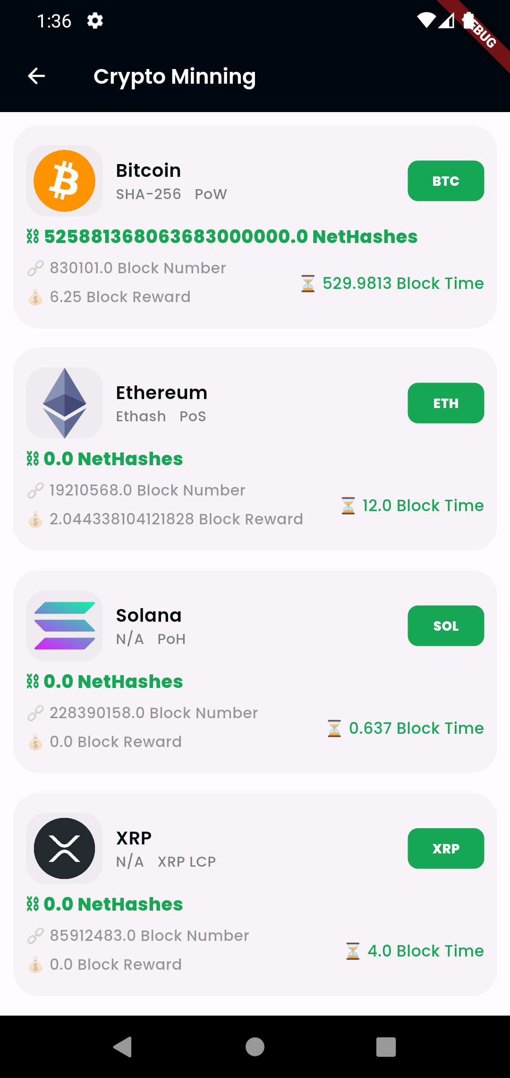
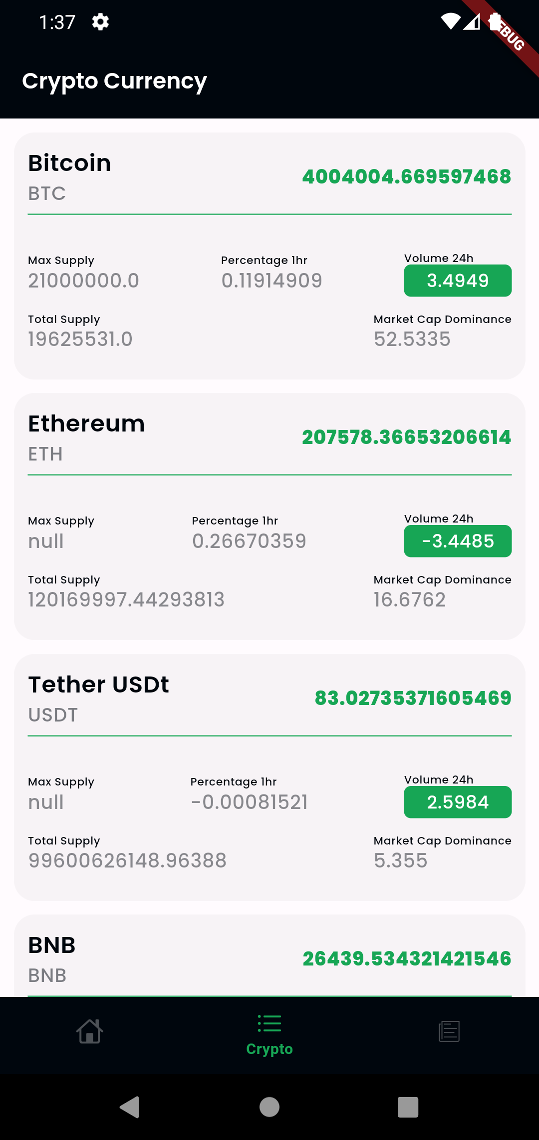
4.2.output designs

Slide 9
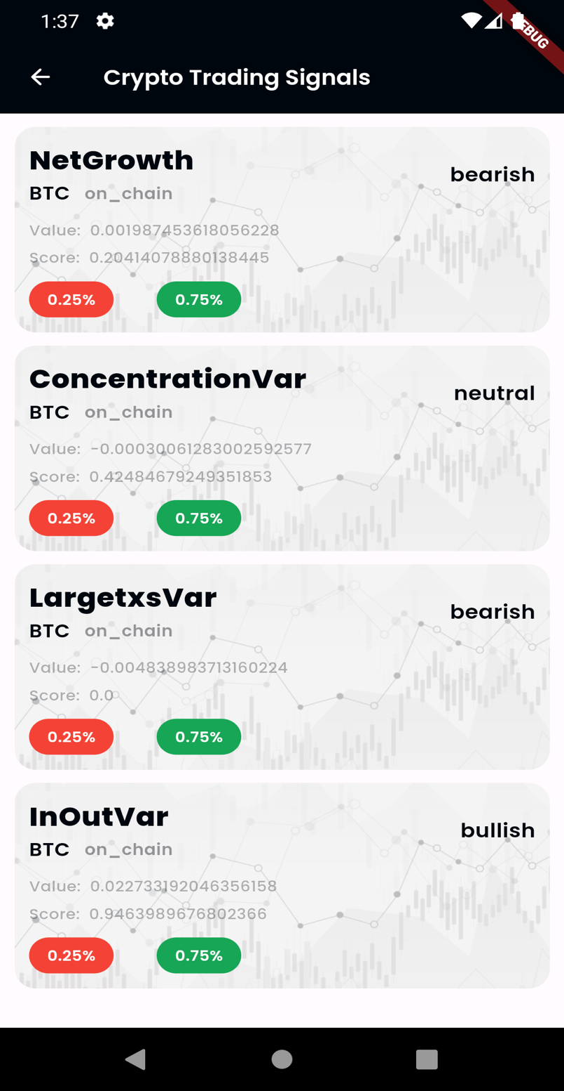
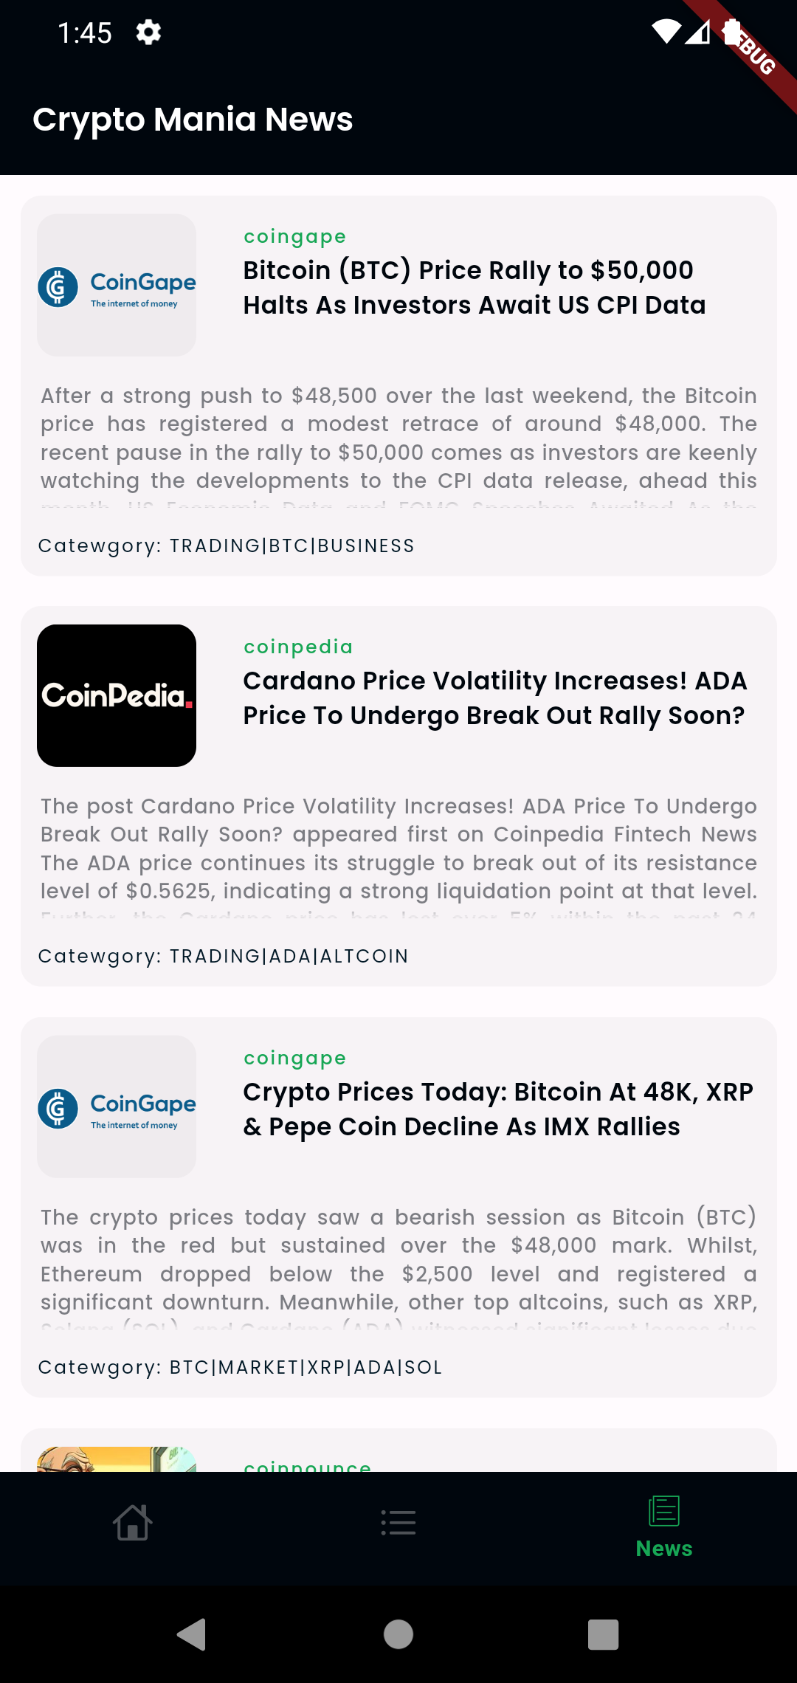
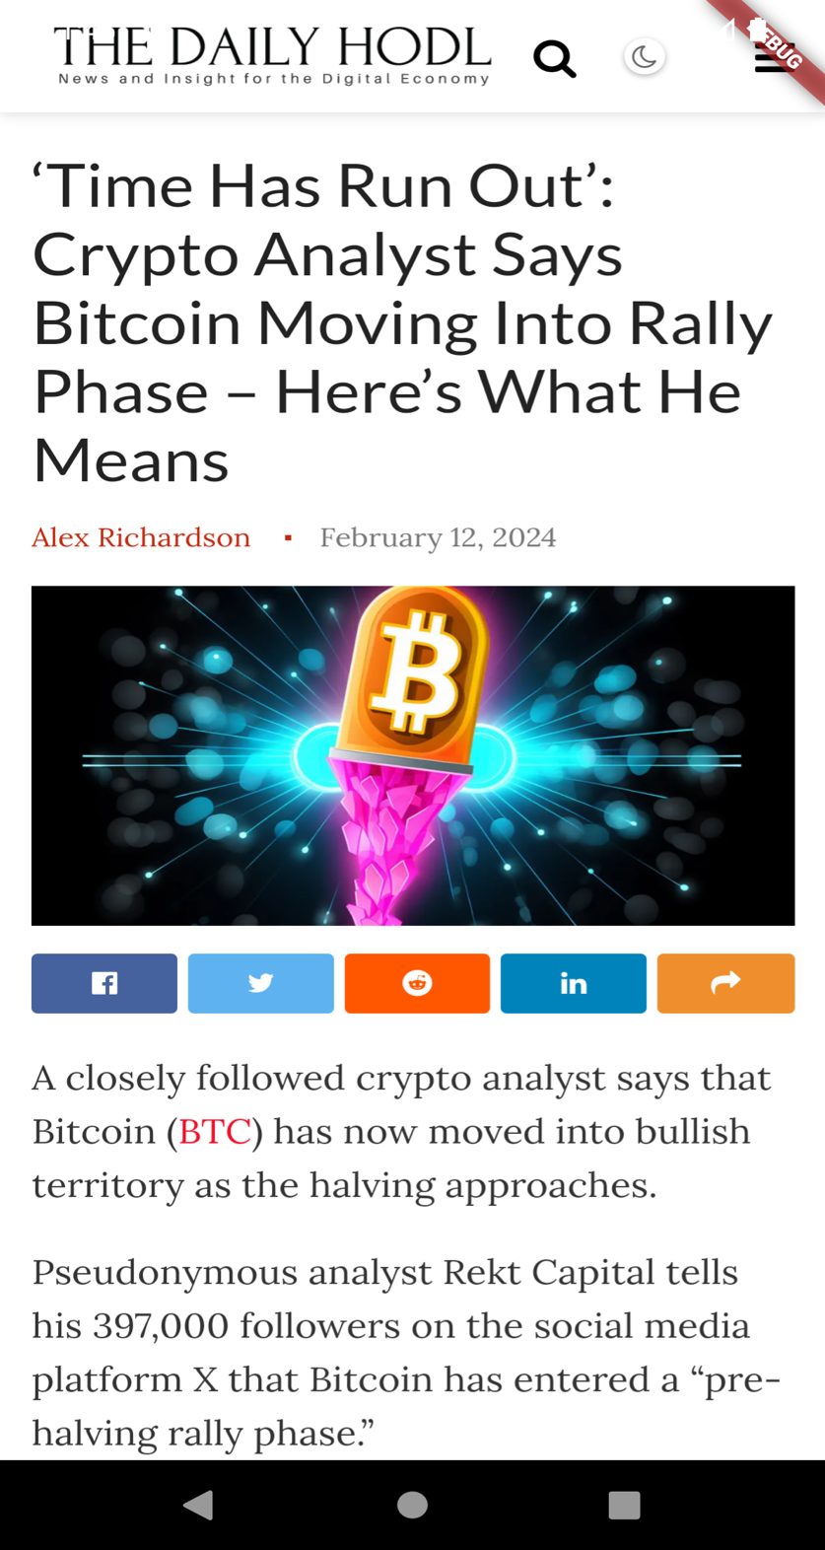

Slide 10
5.CONCLUTION
In conclusion, this cryptocurrency application serves as a bridge between the intricate cryptocurrency market and individuals seeking to engage with it, whether they are seasoned traders, casual investors, or newcomers curious about the digital currency space. The use of CryptoCompare and CoinMarketCap APIs ensures that the application is equipped with a wealth of information, from detailed coin analyses to global market trends, all presented in a user-friendly format. This approach not only elevates the standard for crypto-related applications but also contributes to the overall growth and maturity of the cryptocurrency ecosystem.
This project, therefore, not only stands as a significant achievement in the present but also paves the way for future innovations, contributing to the ongoing transformation of the digital finance landscape.

Slide 11
5.1.Future enhancement
Looking ahead, the cryptocurrency application built on the robust frameworks provided by CryptoCompare and CoinMarketCap APIs has significant room for future enhancements that could further solidify its position as a leading tool in the digital finance space. One of the key areas for development is the integration of artificial intelligence (AI) and machine learning (ML) algorithms. By leveraging AI, the application could offer predictive analytics, enabling users to gain insights into potential future market movements based on historical data and trends. This could include features like price prediction models, sentiment analysis from various news sources and social media, and automated trading strategies tailored to individual user preferences and risk profiles.
As the blockchain technology landscape evolves, there's a growing need for more sophisticated tools that can analyze blockchain data in real-time. This includes tracking wallet transactions, identifying trends in token distribution, and monitoring smart contract interactions. Enhanced blockchain analytics could provide users with deeper insights into market dynamics, contributing to more informed investment decisions.

Slide 12
Thank you

